Slide 1
DSA – Final Project Sleeping Customer // Group 5
By:
Adika F Prabowo
Permadi S Herlambang
Dewa Satria Widnyana
Rizkiy Gagah D

Slide 2
Business Understanding

Slide 3
Around 48.5 Mn prepaid customers become sleeping customers each month.
Background
The sleeping rate in Dec-2019 is approximately 28.7%.
Total Prepaid Customers
169.0 Mn
As of Nov-2019
Definition:
Sleeping Customers Customers that are not generating revenue for the company in a specified month.
Active Customers Customers that are not generating revenue for the company in a specified month.
Sleeping Rate The number of customers divided by the number of total prepaid customers.

Slide 4
We need to execute preventive actions to reduce the sleeping rate from 28.7% to 25%.
Business Objective
Business Succes Criteria
“Reduce the sleeping rate and number of sleeping customers.”
The preventive actions will be considered successful when it can reduce the sleeping rate from 28.7% to at least 25%
-3.7pp
Project Plan
Collect existing customer profile
Predict sleeping customers Knowing potential sleeping customers will increase the efficiency of the preventive actions.
Profile predicted sleeping customers Knowing the profile of potential sleeping customers will allow us to make more effective preventive actions.
Formulate preventive actions
Execute preventive actions

Slide 5
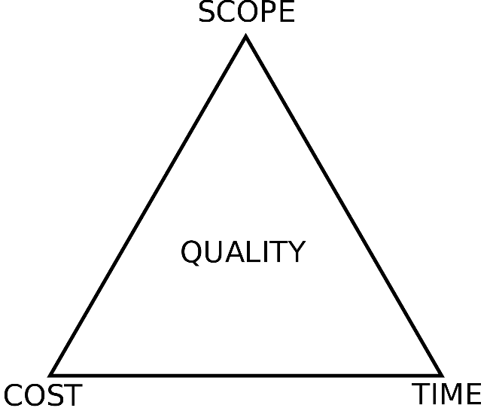
We can only predict potential sleeping customers and profile them due to limited resources.
Assess Situation
1
4
Scope Constraints:
Prior experience on prediction We should be able to predict sleeping customers using classification model
Novice on segmentation Need to learn on how to use clustering model to assist on segmentation.
Project Quality:
Predict sleeping customers
Profile predicted sleeping customers
Formulate preventive actions
Execute preventive actions
2
3
Cost / Resource Constraints:
High amount of data The available data is big
Limited processing power We only use laptop with i5 CPU and no dedicated GPU
No budget for cloud computing We are not given budge to use cloud computing to mitigate the limited processing power.
Time Constraints:
Part time data scientist We still have obligations from our day to day job
No pardon to do the project We were only pardoned for mentoring and project review, but not given time to do the project formally.

Slide 6
Out data mining goals can be categorized as prediction and segmentation.
Data Mining Goals
Data Mining Success Criteria
Prediction Determine what features of customers that will affect them to become sleeping customers in the next month.
Segmentation Divide potential customers into segments so that we can offer them personalized programs.
Prediction Classification model with:
ROC AUC score >= 0.7
F1 score >= 0.7
Segmentation Clustering model with:
Silhouette score >= 0.5

Slide 7
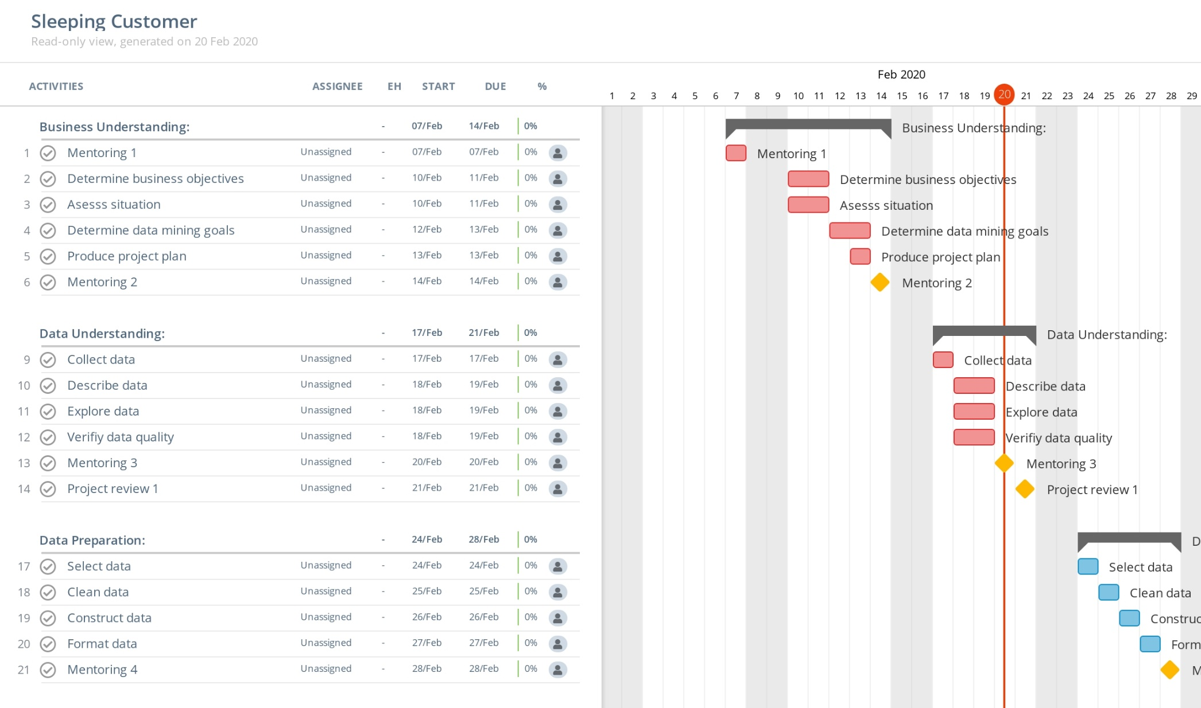
The project timeline will consider mentoring and project reviews as milestone.
Project Plan – Feb 2020
Feb 2020
Business Understanding
Data Understanding
Data Preparation

Slide 8
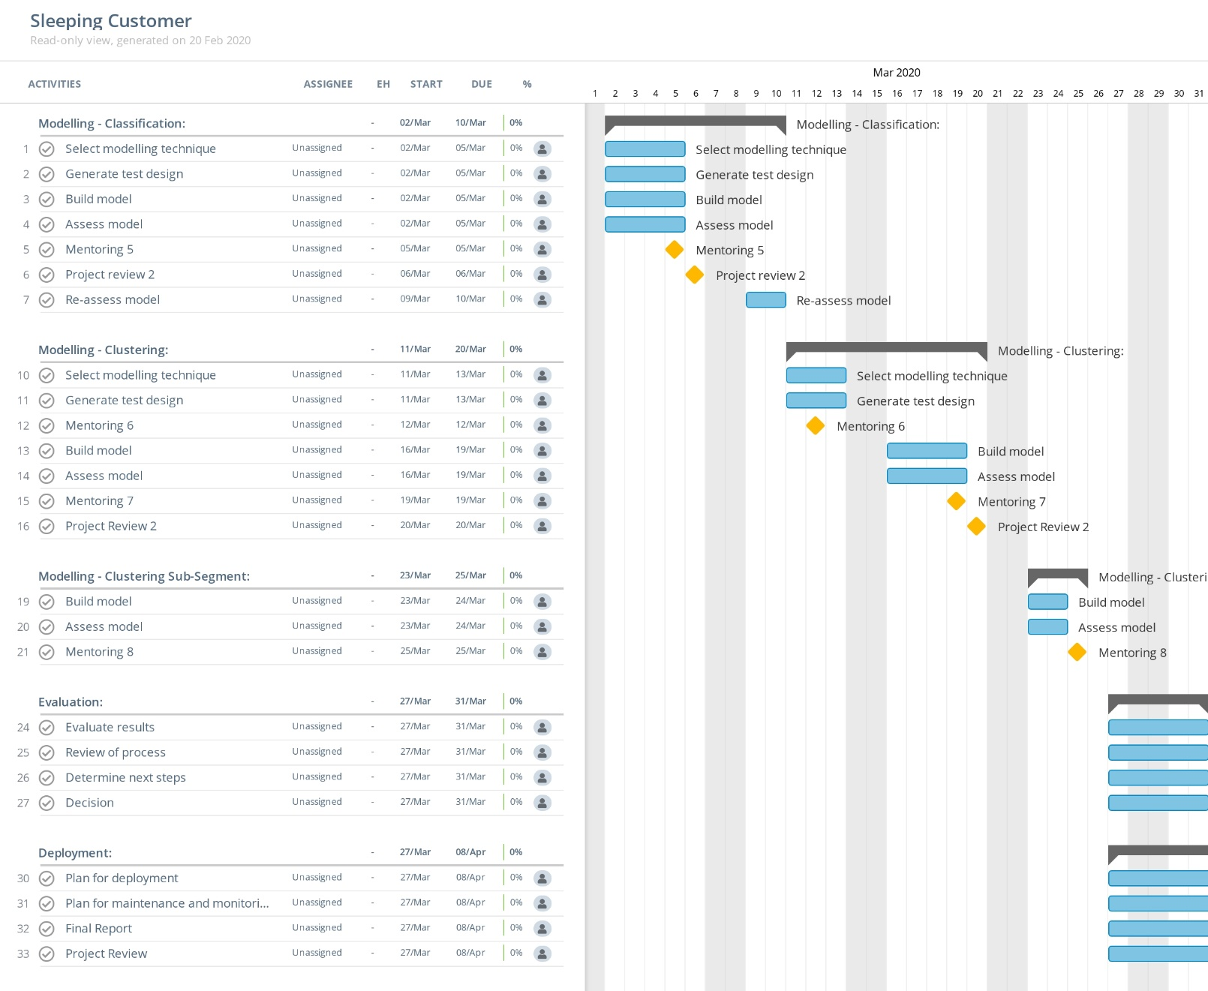
The project timeline will consider mentoring and project reviews as milestone.
Project Plan – Mar 2020
Mar 2020
Modelling – Classification
Modelling – Clustering
Modelling – Clustering Sub-Segment
Evaluation
Deployment

Slide 9
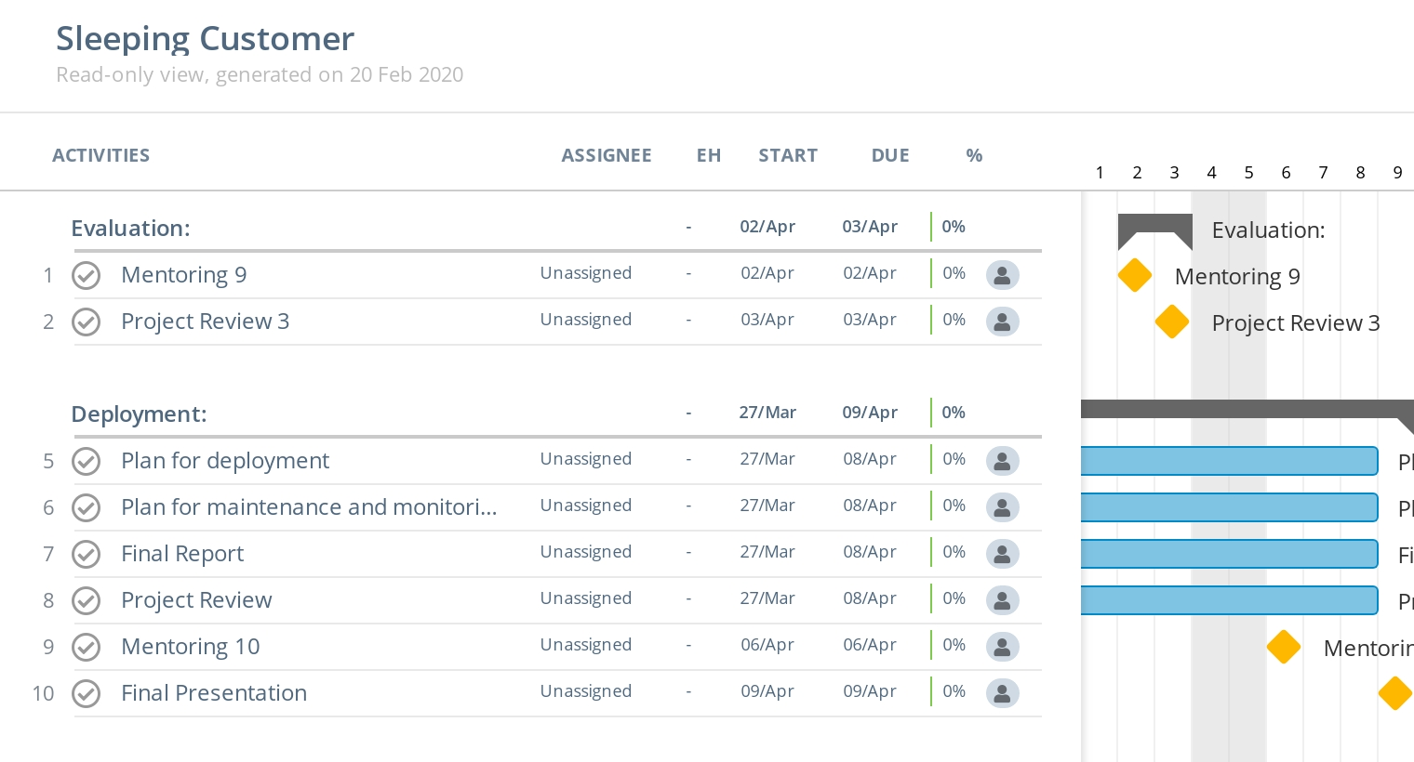
The project timeline will consider mentoring and project reviews as milestone.
Project Plan – Apr 2020
Apr 2020
Evaluation
Deployment

Slide 10
Data Understanding

Slide 11
There are 5 tables in the database with only available data from one month.
Dictionary
1..1
flag login MyTsel
1..1
0..1
1..1
1..1
1..1
1..1
1..1

Slide 12


We sample 999,999 customers out of the population.
Table names
Row counts
Total Population
139,511,309
non_rgb_baseline
139,511,309
MySQL
non_rgb_mytsel
18,324,657
Stratified
Random Sampling
Confidence Level 95%
Confidence Interval 10%
Detail
non_rgb_recharge
139,511,309
Transform
non_rgb_regional
139,511,309
non_rgb_usage
139,511,309
Total Sample
999,999

Slide 13
Data Preparation

Slide 14
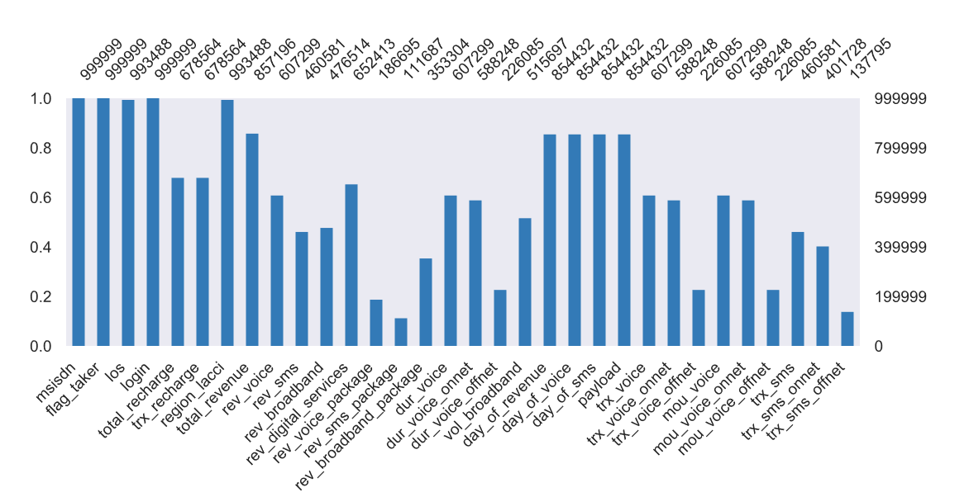
Clean Data
Most of the features have null values, due to improper formatting in the data warehouse
Null values in mytsel login → Change to False
Null values in recharge and usage columns → Change to 0
6,511 rows with null values in los and region lacci → Drop rows

Slide 15
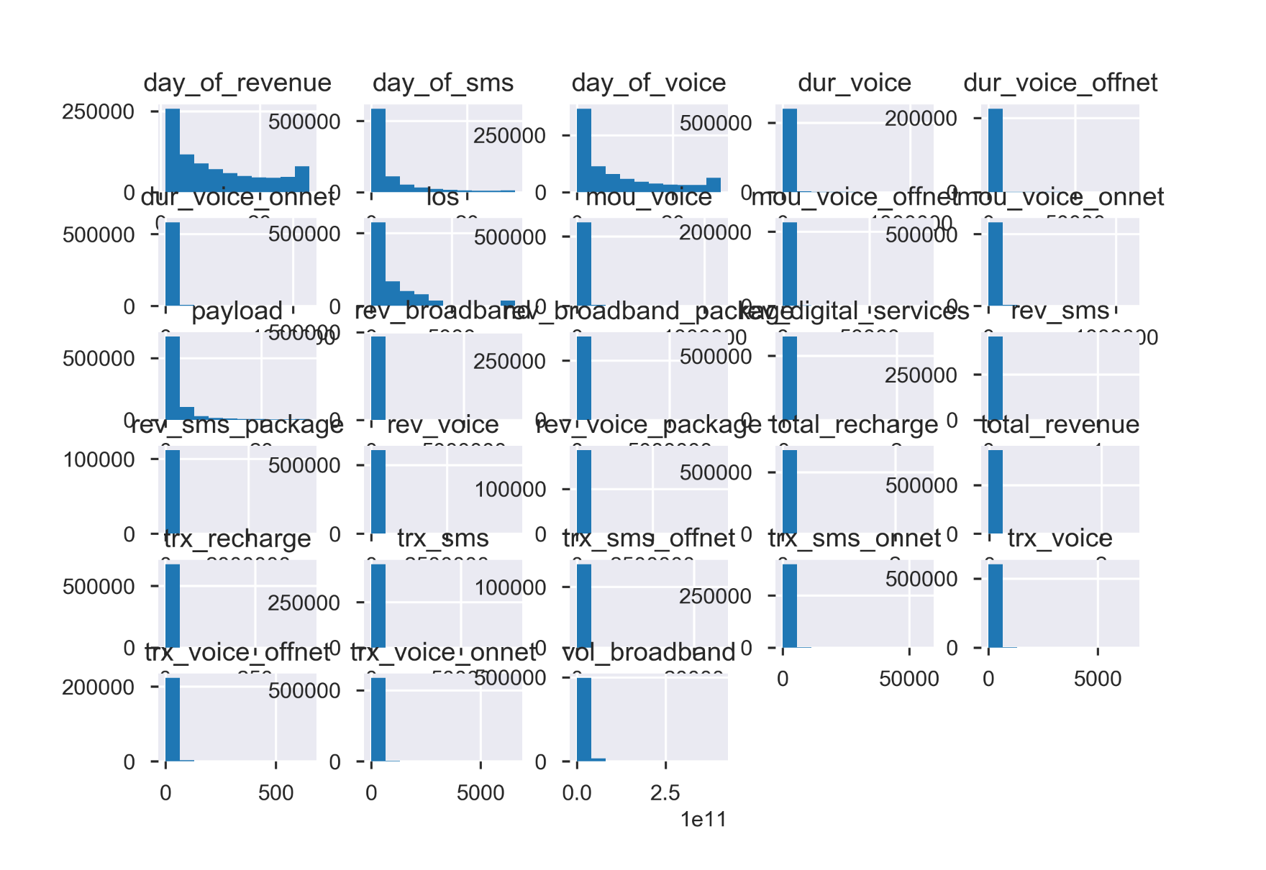
Clean Data
Most of the features are extremely right skewed
Day of revenue, day of sms, day of voice and los are right skewed too, but not as extreme

Slide 16
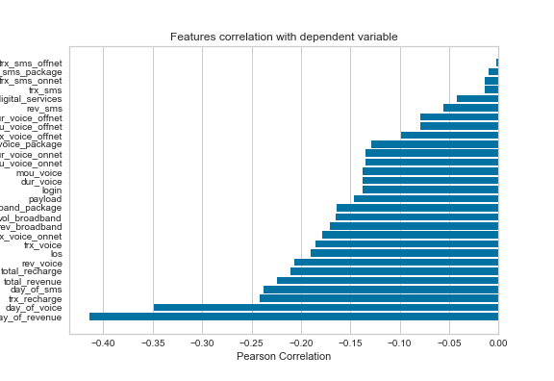
Clean Data
All of the features have negative relationship with flag taker (non RGB)
Day of revenue have the strongest negative relationship (-0.41)
Followed by day of voice with -0.35

Slide 17
Model Design
We use supervised model to predict the potential user who turned into Non RGB on Next Month
Model Formulation
Result
Preparation
Algorithm 1
Confusion Matrix
Scaler
Algorithm 2
Model Performance
Encoding
Algorithm 3
ROC
Splitting Train & Test
Algorithm 4
Features Importance

Slide 18
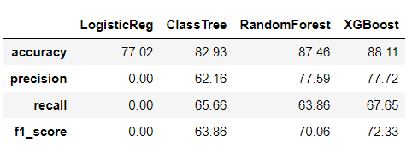
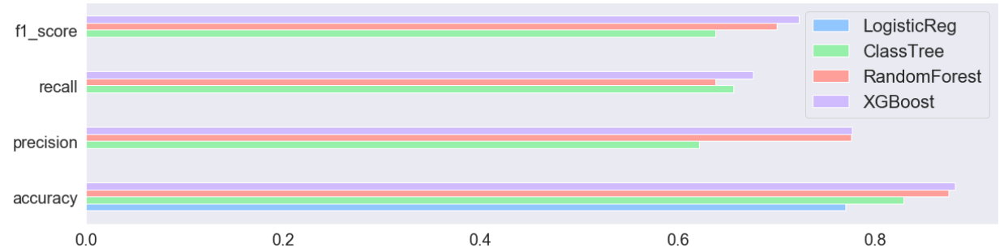
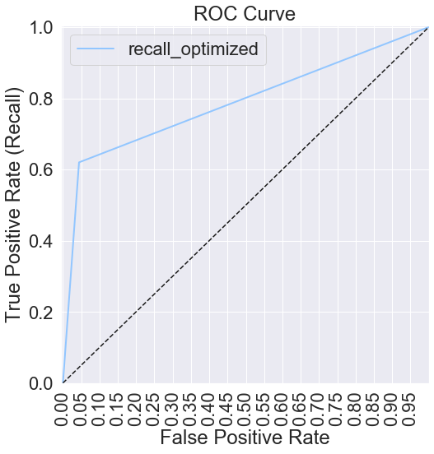
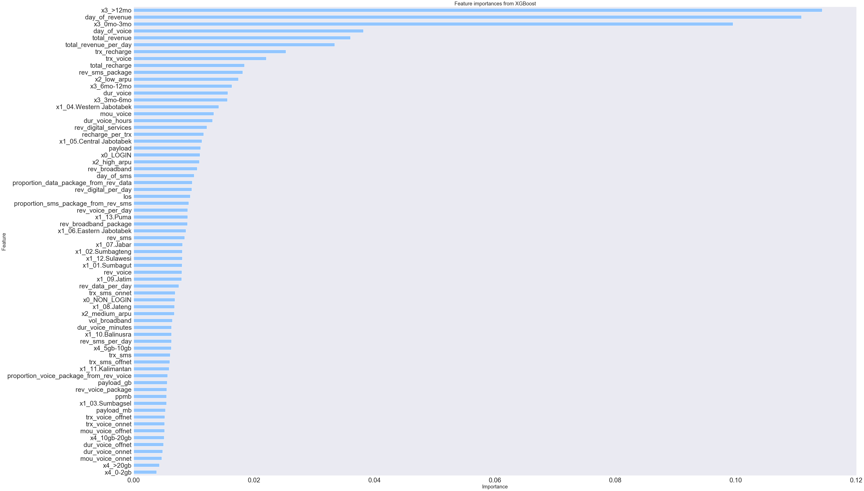
Result Model 1st Iteration
For the 1st iteration, highest number of F1 Score is using XGBoost with 72.33%, then the AUC Score is 78.7%
Feature Importances
AUC Score: 78.7%

Slide 19
For the 2nd iteration, we used data set with fewer features.
We found duplicate features that need to be removed and exclude derivate features.
Data Source
Feature Engineering
2nd Iteration Data Set
Table Name | Feature Type | Count
Baseline | Numerical | 1
Recharge | Numerical | 2
Usage | Numerical | 25
MyTsel | Boolean | 1
Regional | Categorical | 1
Total |  | 30
Table Name | Feature Type | Count
Baseline | Numerical | 1
Recharge | Numerical | 2
Usage | Numerical | 13
MyTsel | Boolean | 1
Regional | Categorical | 1
New | Numerical | 6
Total |  | 24
Rename Payload to Day of Broadband
Exclude 9 derivative features from Usage
Remove 3 duplicate features from Usage
Add 6 new features
Notes:
MSISDN is data identifier and not included as features
Flag Taker is data label/identifier and not included as features
Derivative features include Rev Voice Package, Dur Voice Onnet, etc
MoU Voice is a duplicate of Dur Voice

Slide 20
LightBGM classifier with MaxAbs scaler and WoE encoder have the best ROC AUC.
ROC AUC of 0.92 and F1 score of 0.72 from the best combination.
Base Model Pipeline
Overall LightBGM have best ROC AUC
Feature Type
Imputer
Scaler
Classifier
Numerical
0
5 candidates
Boolean
5 candidates
Encoder
Categorical
Missing
3 candidates
Notes:
Base model trial using GridSearchCV with 5-fold cross validation

Slide 21
Tomek Link under sampling and hyper parameter tuning barely increase the ROC AUC.
Even after using resampling and hyper parameter tuning the ROC AUC increases to 0.93 and F1 score increases to 0.73.
Tuned Model Pipeline
Feature Type
Imputer
Scaler
Resampler
Hyper Parameter
Classifier
Numerical
0
MaxAbs
Boolean
7 candidates
576 candidates
LightBGM
Encoder
Categorical
Missing
WoE
Notes:
Resampler trial using GridSearchCV with 5-fold cross validation
Hyper parameter trial using 60 iteration RandomizedSearcCV with 5-fold cross validation

Slide 22
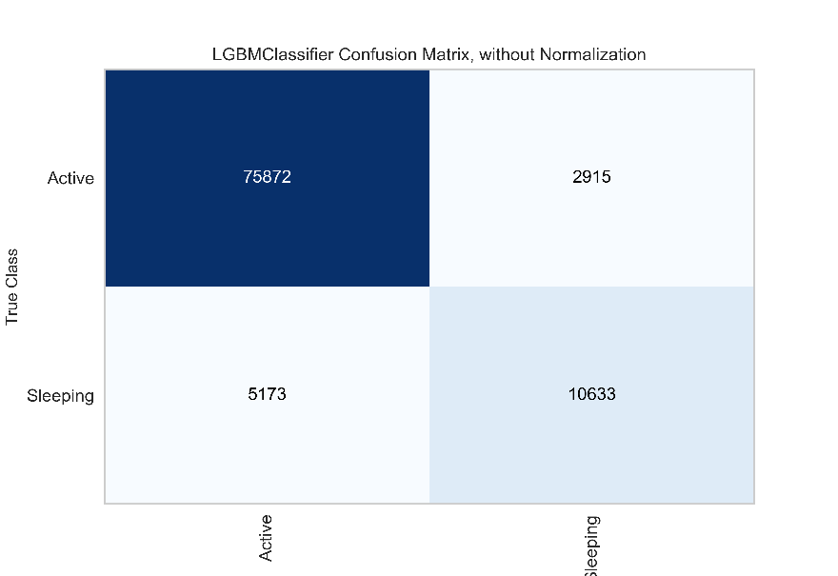
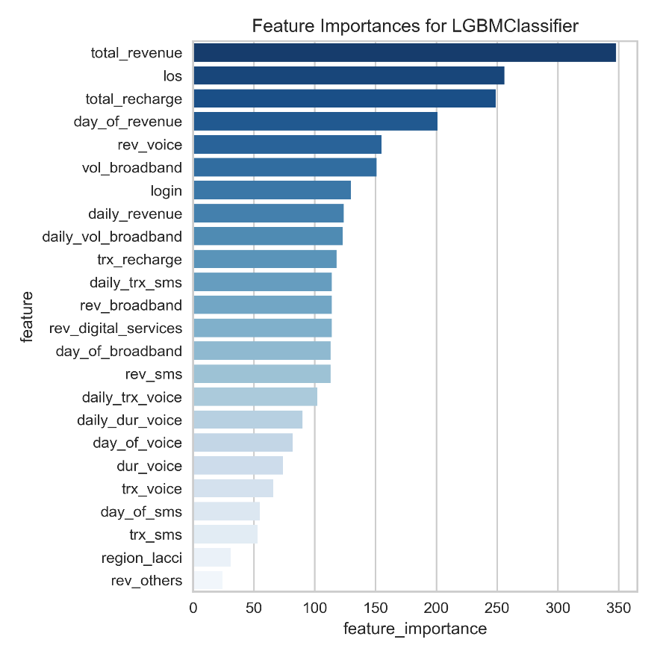
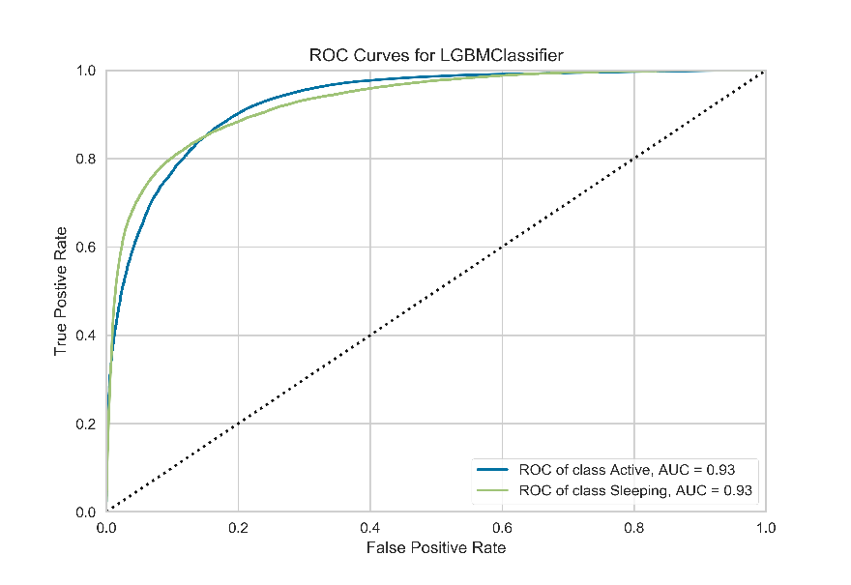
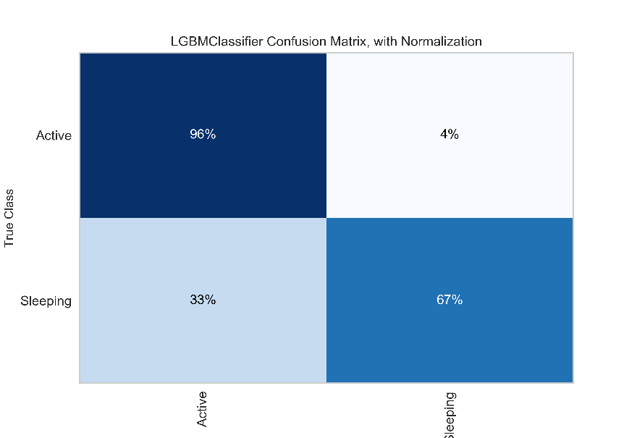
Total revenue have the highest feature importance, followed by LoS and total recharge.
New features from feature engineering have average feature importance at best.

Slide 23
For the 3rd iteration, we used derivative features and add 45 new features.
New features includes revenue proportions, usage proportion, etc.
Data Source
Feature Engineering
3rd Iteration Data Set
Table Name | Feature Type | Count
Baseline | Numerical | 1
Recharge | Numerical | 2
Usage | Numerical | 25
MyTsel | Boolean | 1
Regional | Categorical | 1
Total |  | 30
Table Name | Feature Type | Count
Baseline | Numerical | 1
Recharge | Numerical | 2
Usage | Numerical | 22
MyTsel | Boolean | 1
Regional | Categorical | 1
New | Numerical | 45
Total |  | 72
Rename Payload to Day of Broadband
Remove 3 duplicate features from Usage
Add 45 new features
Notes:
MSISDN is data identifier and not included as features
Flag Taker is data label/identifier and not included as features
Derivative features include Rev Voice Package, Dur Voice Onnet, etc
MoU Voice is a duplicate of Dur Voice

Slide 24
We then retrain Tuned Model using the selected data set.
Although there is an improvement in ROC AUC, the score is still 0.93
3rd Iteration Data Set
Feature Selection
3rd Iteration Selected Data Set
Table Name | Feature Type | Count
Baseline | Numerical | 1
Recharge | Numerical | 2
Usage | Numerical | 22
MyTsel | Boolean | 1
Regional | Categorical | 1
New | Numerical | 45
Total |  | 72
Table Name | Feature Type | Count
Baseline | Numerical | 1
Recharge | Numerical | 2
Usage | Numerical | 21
MyTsel | Boolean | 1
New | Numerical | 43
Total |  | 69
Boruta Algorithm:
Remove rev sms package from Usage
Remove region lacci from Regional
Remove 2 new features
Notes:
MSISDN is data identifier and not included as features
Flag Taker is data label/identifier and not included as features
Derivative features include Rev Voice Package, Dur Voice Onnet, etc
MoU Voice is a duplicate of Dur Voice

Slide 25
The tuned model predicted that 19K RGB customers will turn into sleeping customers.
We use 525K RGB customers with LoS > 1 year on the tuned model.
RGB Customer with LoS > 1 year
Tuned Model
Tuned Model Prediction
525K
525K
19K
RGB Customer
Predicted Sleeping Customer

Slide 26
Summary all iteration
After we did 3 times iteration, we choose xxx because yyy

Slide 27
Clustering

Slide 28
Profiling & Segmentation Preparation
We build Predicted Non RGB segmentation by leveraging K-Means algorithm using 67 variables
Variables
Data Observation
RGB Customer in November (Sample)
Total population 525K
LOS > 12 Months
525K
RGB Customer
Predicted Sleeping Customer
19K
K-Means clustering is a method for cluster analysis in data mining that aims to partition n observations into k clusters in which each observation belongs to the cluster with the nearest mean
Methodology

Slide 29
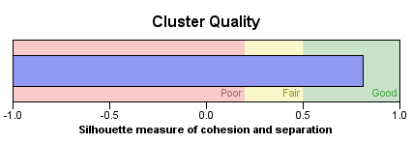
Segmentation Methodology
We used K-Means algorithm and grouped Postpaid Enterprise User into 5 clusters
Segmentation Summary
Path2Sleep
2.6%
0.66
Dormancy 22.5%
Thrifty 70.5%
Loyalist
3.1%
Conserver 1.2%
Data as of January 2020

Slide 30





Predicted Non RGB
The input variables describe a segment together and the segments can only be described compared to each other
Subs
(K)
%
Subs
ARPU All
ARPU Data
Recharge
MoU
(Min)
LOS
(Day)
Description
1
13.7
70.5%
30
11
591
0
847
Low spender
Thrifty
2
0.5
2.6%
1
0
0
0
8912
ARPU < 10
Path2Sleep
3
LOS > 12 Months, High Spender
0.6
3.1%
6387
6246
3840
0
736
Loyalist
4
Mostly using voice
service
0.2
1.2%
385
181
287
76
680
Conserver
5
4.4
22.5%
0
0
0
0
2821
Lowest at all features
Dormancy

Slide 31
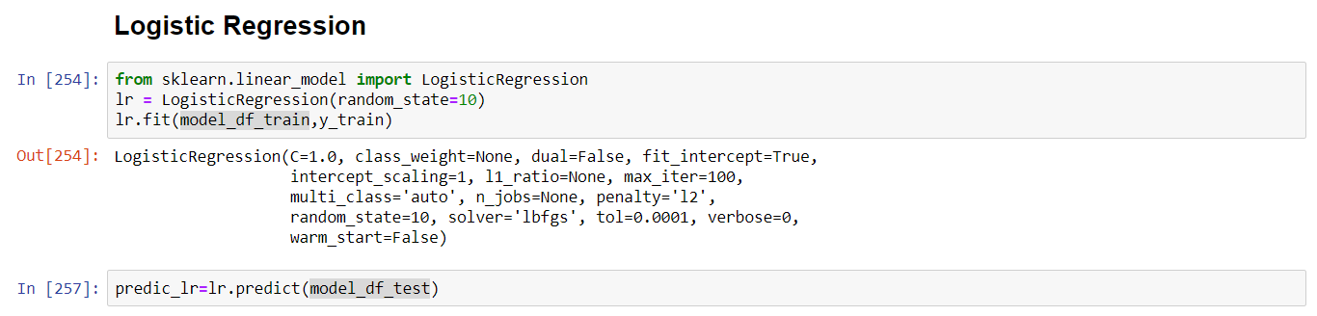
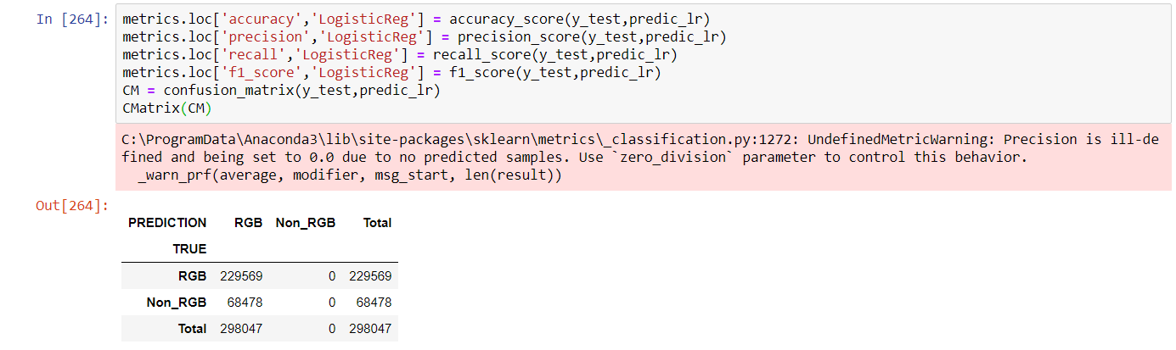
Logistic Regression

Slide 32
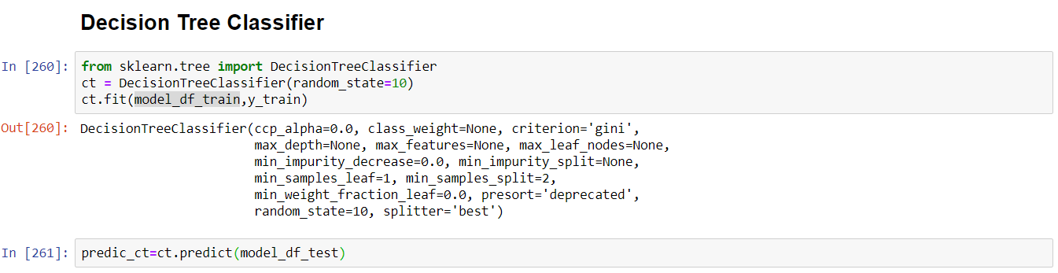
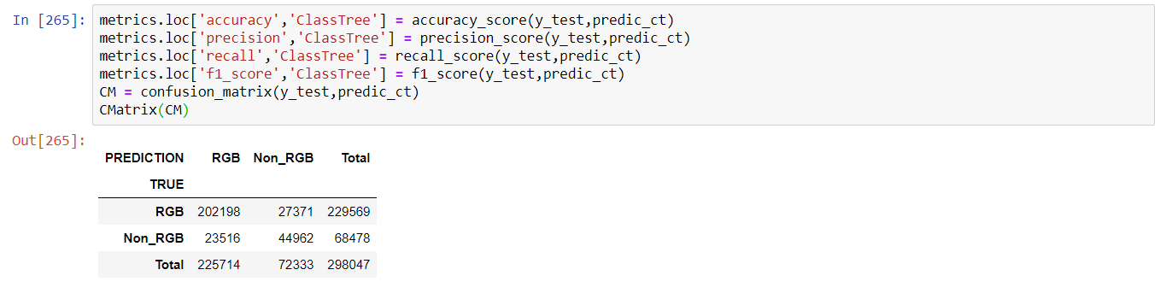
Decision Tree Classifier

Slide 33
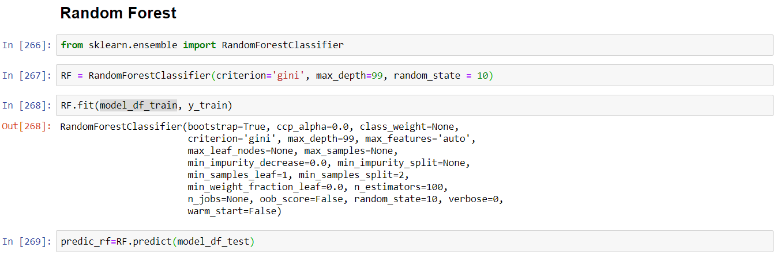
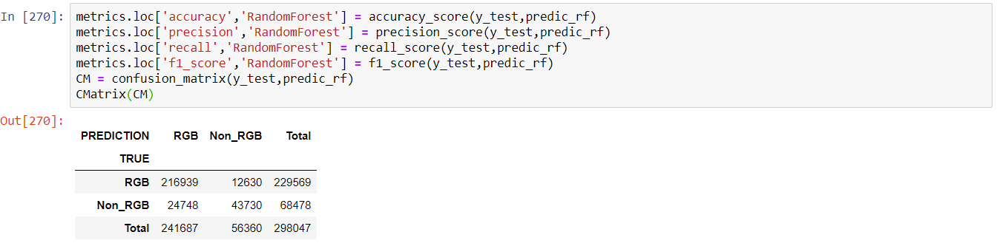
Random Forest

Slide 34
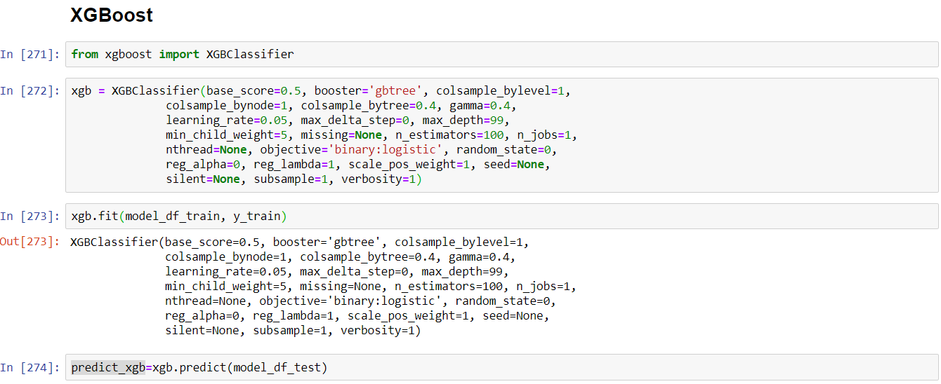
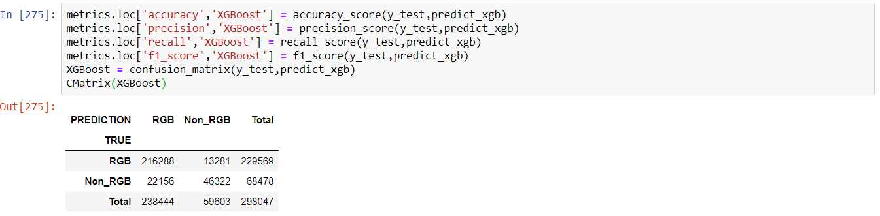
XGBoost

